Slide 1
Chennai – India 14 December 2019

Slide 2





Notes:
Good morning guys! Before I begin, I thank all our sponsors to make this event more successful.

Slide 3


Azure Synapse Analytics
dinesh-kumar-prabakaran-b95a6656/
dinuswt22
@Chennai
Dinesh Kumar P
Product Manager – Dashboard Analytics, Bold BI
Notes:
Myself Dinesh Kumar Prabakaran, Product Manager in Dashboard Analytics team for the product Bold BI. Ok cool.
May I know how many of your work is around DATA most of the time? Either it could be ML / ETL / BI or so. That’s a nice count ☺
How many are familiar with the term ‘Synapse Analytics’?

Slide 4
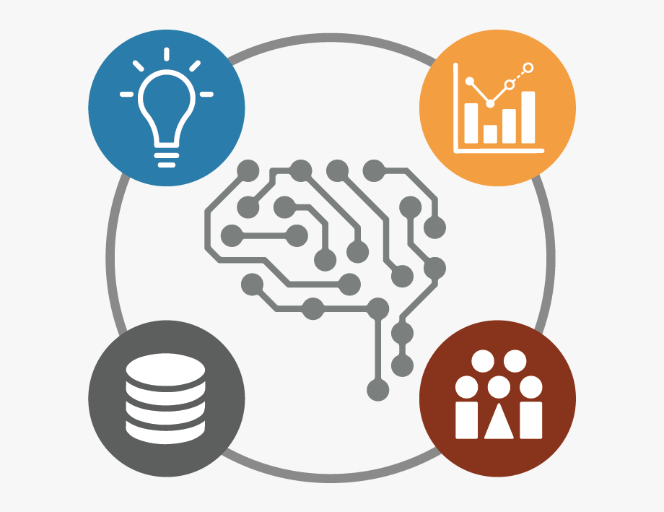

Common challenges in ML projects
Azure Synapse Analytics
Notes:
As you see, I am going to talk about,
Some common challenges in ML projects.
Next about Azure Synapse Analytics.
And finally - a demo how I have built a common AI use case pipeline is built.

Slide 5

For what basic skill, different people get different salaries?
$10,000
$5000
$1000
$500
$50
Notes:
Let me ask a simple question. For what basic skill, different people get different salary? Perhaps that is the same basic thing which all the ML or AI projects are solving and make our life easier.

Slide 6
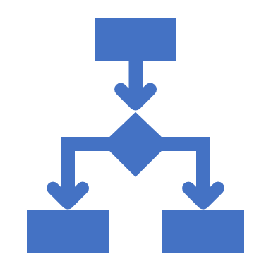


Decision Making
Notes:
Its DECISION MAKING. And that’s what AI is doing for Humans right? I can say many real time examples for this. For now, lets take - the Google Maps. Before 5 years, if you are riding to a destination for which you don’t know the route, you will constantly ask the persons who are on your path way, think over the route and go on. But now, Google Maps in our mobile phone, decides and tells this is the right route. And we are travelling just by looking into that Map path. Notice that here decision making work is partially taken over by the software comparing to the same situation before 5 years.
Software are no more just software. As engineers, we are making them as intelligent agents and make them evolve as more human in nature. Simply say, future machines with software will slowly rise to the conscious level of humans even!

Slide 7
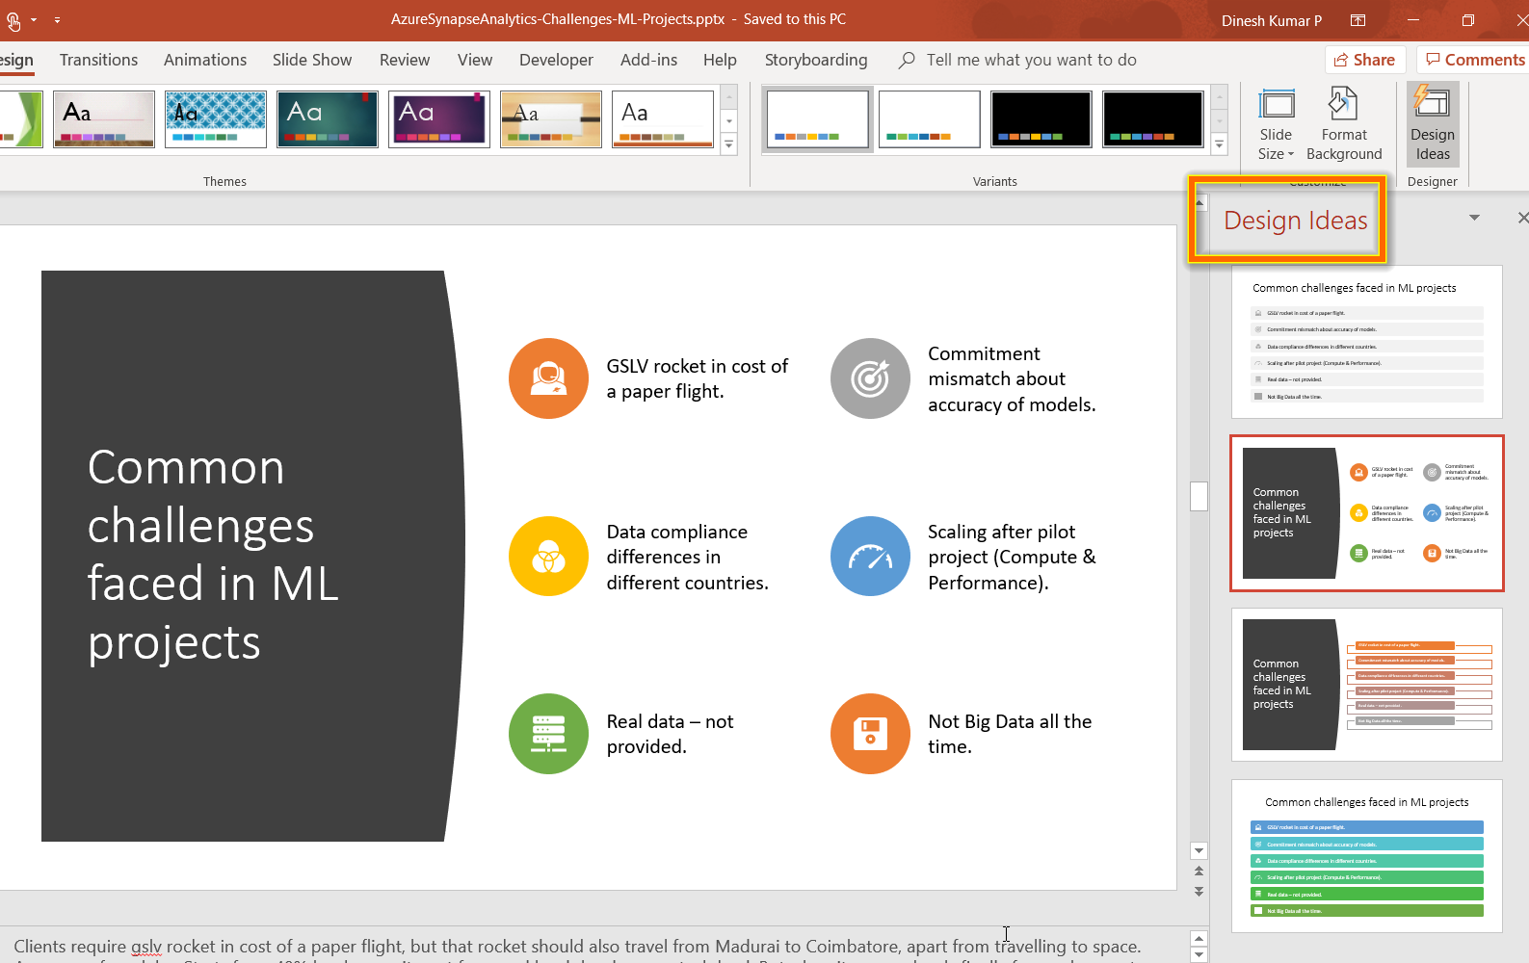
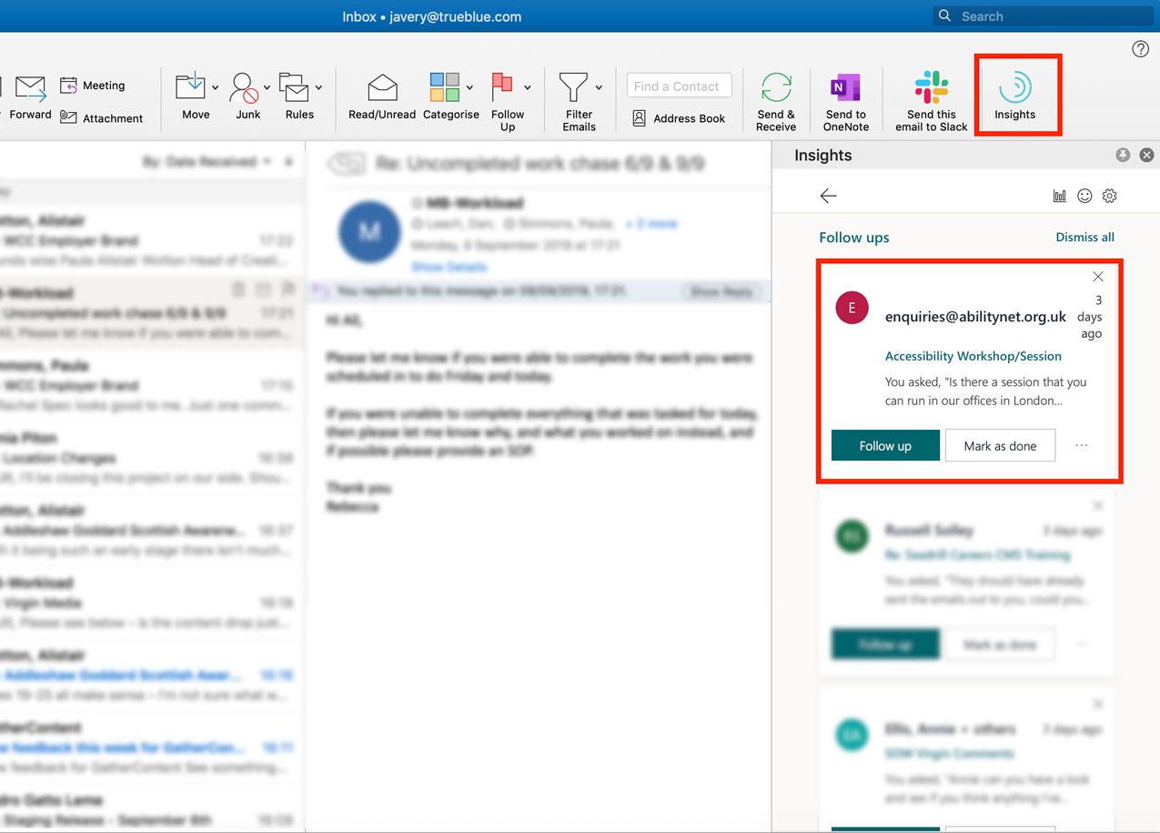
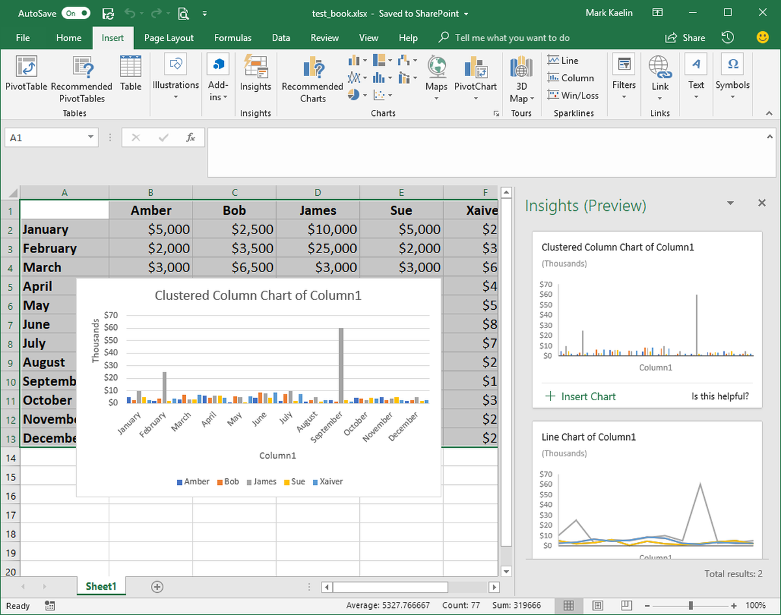
PowerPoint
Outlook
Excel
Notes:
AI is everywhere. As you see in the slide,
‘Design Ideas’ in PowerPoint suggests you good designs and icon sets for the content, in a fraction of second than a human can think.
‘Insights’ in outlook lets you know, if anything you have promised is getting missed out without addressing it.
‘Ideas’ in Excel, automatically decides the suitable chart based on the data you have and populates it right inside of the Excel app automatically.

Slide 8
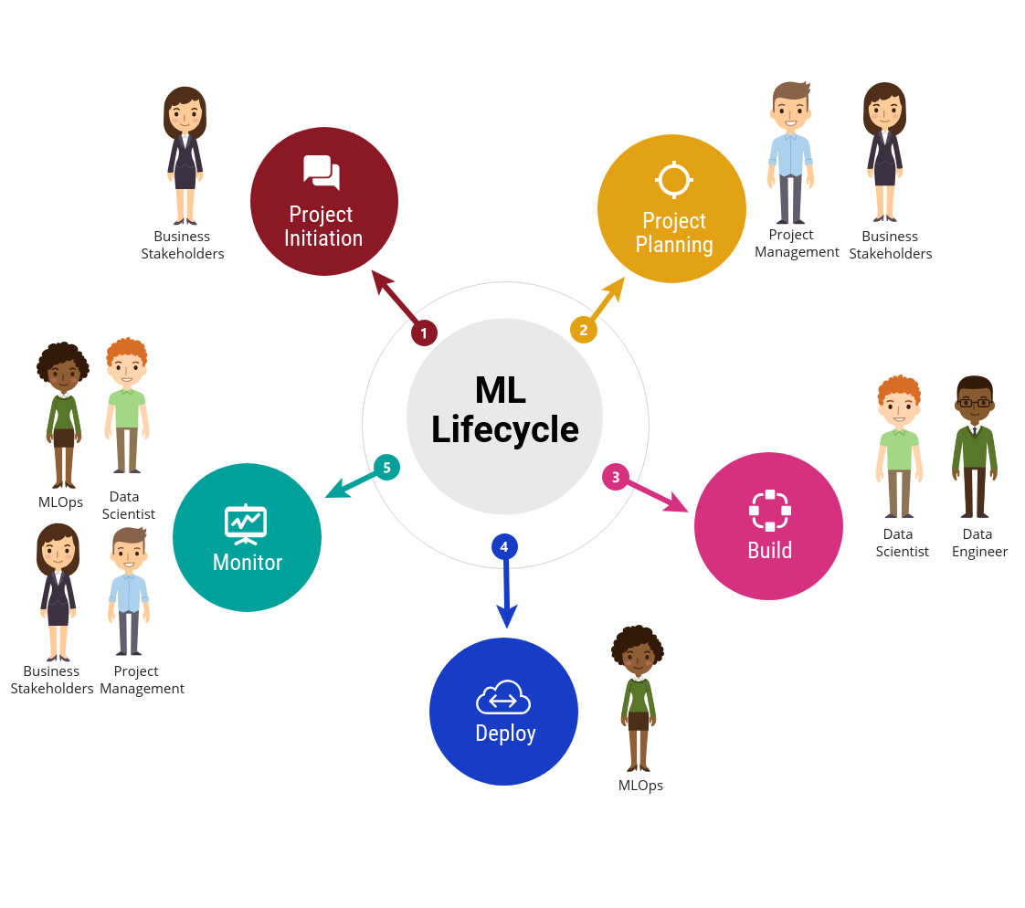
Image source - https://predera.com/ai-biggest-struggle-yet-no-streamlined-mlops-as-a-service/
Notes:
Technology is getting more powerful every day. We have countless ways to collect data, play with it to get insights out of it. But the real challenge is finding the right tech stack to engineer which is stable enough to store, process, visualize and get insights.
And don’t forget that, the number of persons may vary based on team size or office size. But the number of personas are same for any ML project.

Slide 9
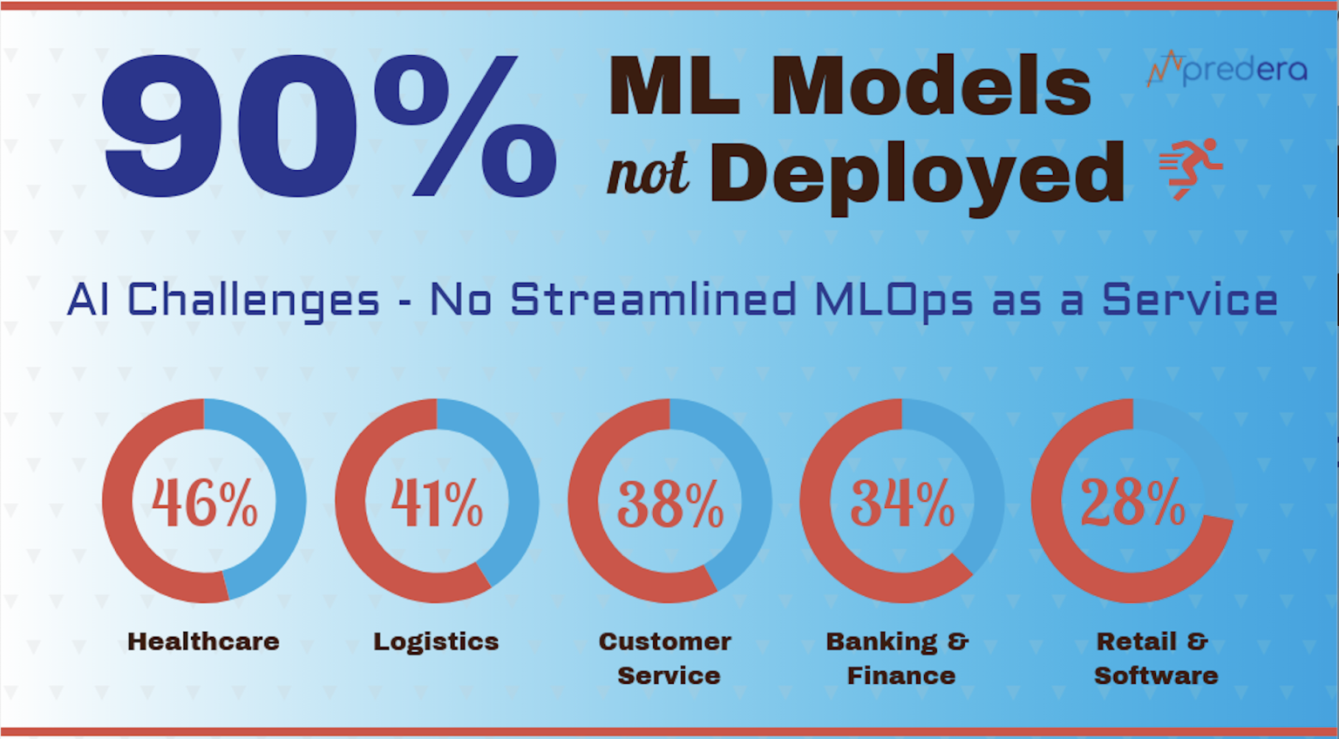
To Production
Image altered from source - https://predera.com/ai-biggest-struggle-yet-no-streamlined-mlops-as-a-service/
Notes:
A study says, 90% of ML models are not moved to production and stuck hold in any 1 of the life cycle space saw in previous slide.

Slide 10
Common challenges faced in ML projects
COST - GSLV rocket in cost of a paper flight.
COMMITMENT mismatch about accuracy of models.
COMPLAINCE, security differences between nations about data.
SCALING after pilot project (Compute & Performance).
REAL data – not provided.
NOT BIG DATA all the time. Data scientist - SQL knowledge.
CONNECTORS both for ingestion and retrieval.
CLOUD practice goes by company’s nature (Azure / AWS / …)
Notes:
Clients require gslv rocket in cost of a paper flight, but that rocket should also travel from Madurai to Coimbatore, apart from travelling to space.
Accuracy of models - Starts from 40% level commitment from end level developer or tech lead. But when it crosses levels finally from sales guy to customer it's conveyed as 90% commitment. Such hyped promises create last minute dropout by client without the ML model getting productionized.
Lot of compliance especially health care. The working solutions are not able to move to production in all regions say all countries.
Many ML projects struggle when the question of fact comes to scaling after successful pilot project (Storage, Computation & Performance).
Real data is not given by client to dev team who build models, due to trust factor. This creates difference in success rate of models while tested in dev and customer environment.
Don’t go for Big Data stuff always. My own experience - Spark failed and finished with Postgre SQL. Though, SQL is not the language to perform “science” on the data, but it is the language to pull and manipulate the data. For most of the Exploratory Analysis with minimal cleanup over say 2 billion rows of data, you don’t need to being it R or Python memory.
Choosing a service depends on factors - cloud platform being used most in your office may not have your choice of service. And mainly budget.
While choosing - see to that, you are not choosing which you are comfortable with. Rather choose the best fit for the use-case or problem that you are going to solve.

Slide 11

Time-Series Analysis
Most of the BI tools, including Power BI uses “Exponential Smoothing” for Time series forecasting. (Note: Which is not used by ML.Net)
Data => WINE.
From how old it is stored – More accurate the prediction!
Notes:
My new phrase ☺ rather telling as Gold or Oil

Slide 12
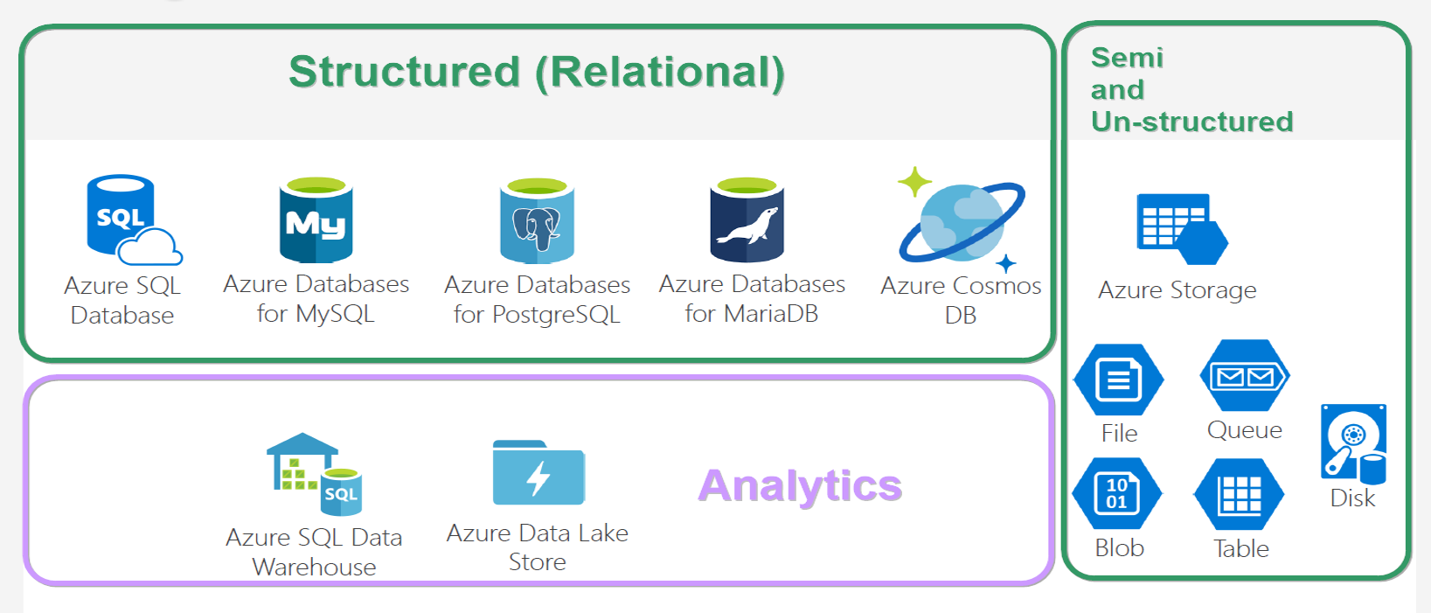
Database options
Notes:
And these are the tech stack that - giants like Microsoft, Amazon are trying to address with their services. Each of them are good at each problem statement.
Apart from algorithm it is also important to pick the right database option for the right use case.

Slide 13
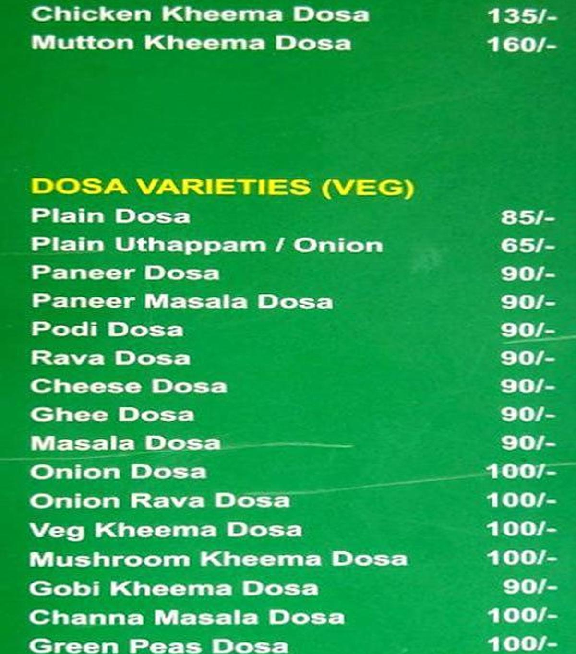
Dosa options !!
Notes:
And looking at thie, oes both give same feeling? ☺

Slide 14
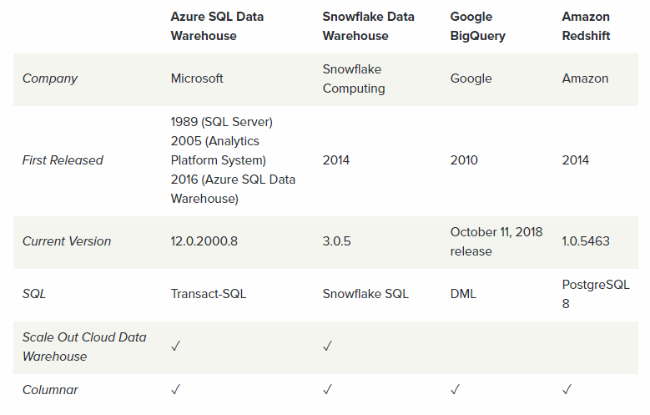
https://gigaom.com/report/data-warehouse-cloud-benchmark/
Notes:
Upon all, in today’s talk, let us take options related to Analytics. In that Azure SQL Warehouse in specific. Here we have the comparison between different cloud data warehouse solutions. Azure SQL Data Warehouse is a warehouse service provided by Microsoft is like Google's Big Query and Amazon's Redshift. Warehouse needed when Massive Parallel Processing and OLAP requirements are front and center of the need.
Warehouse primarily addresses the Scaling issue for both Storage and computation. Even you can use Warehouse only for computation with your data reside in Azure Blob or HDFS via Polybase.

Slide 15
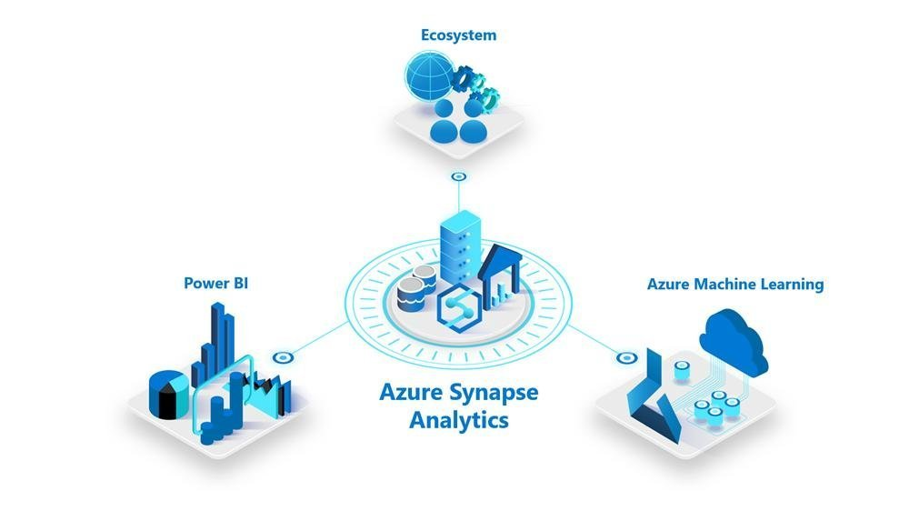
Notes:
Azure Synapse Analytics is the next generation of Azure SQL Data Warehouse blending big data, data warehousing and data integration into a single service for end to end analytics. Scratched-up from ground-level to address best performance than Google Big Query and Amazon Redshift.
Having everything from Ingest, Explore, Analyse, Visualize in one studio - makes Context switching reduced so much. And thus save developer time as well. That’s what all the apps are trying to implement. (Whatsapp – Youtube, Azure DevOps, Teams plugins)

Slide 16
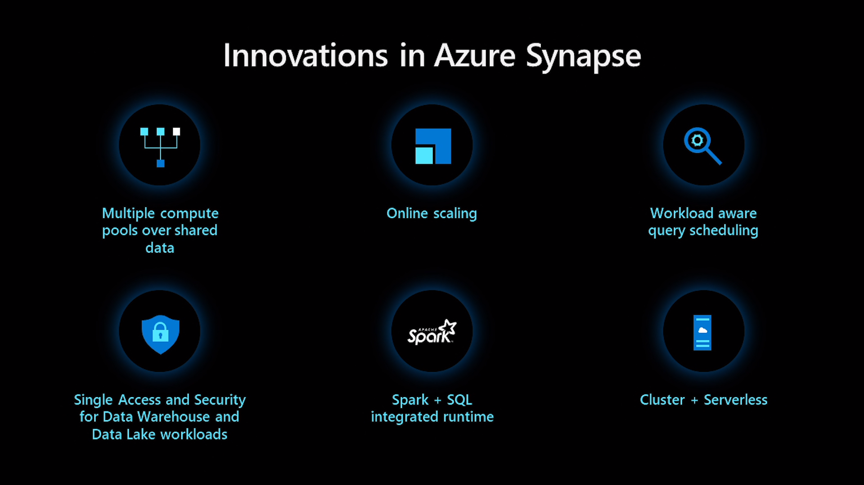
Notes:
Serverless DW + Code Free and Code full ETL + ML + Visualization + Multi lingual (SQL, Python, C#) Platform.

Slide 17
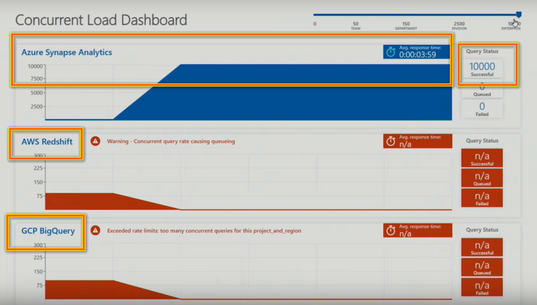
Notes:
In general data warehouse services will have a minimum concurrency allowed. But in Synapse you can see upto 10,000 OLAP queries it is able to process over TBs of data which other key competitors fails even to accept the connection.

Slide 18
Single Studio for entire data team
Database Engineer Storage accounts, Databases, Datasets.
ETL Engineer Pipeline and Flow.
Data Analyst, BI engineer, Data Scientist Development.
All of them compatible with Azure AD – access level security.

Slide 19
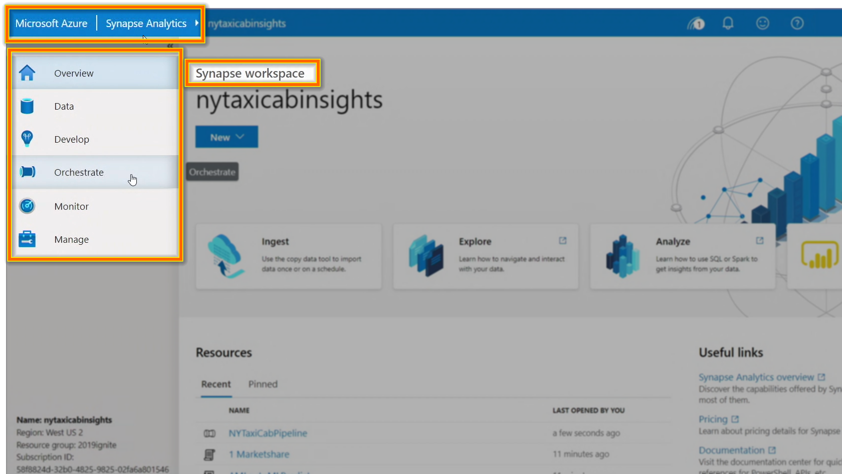

Slide 20
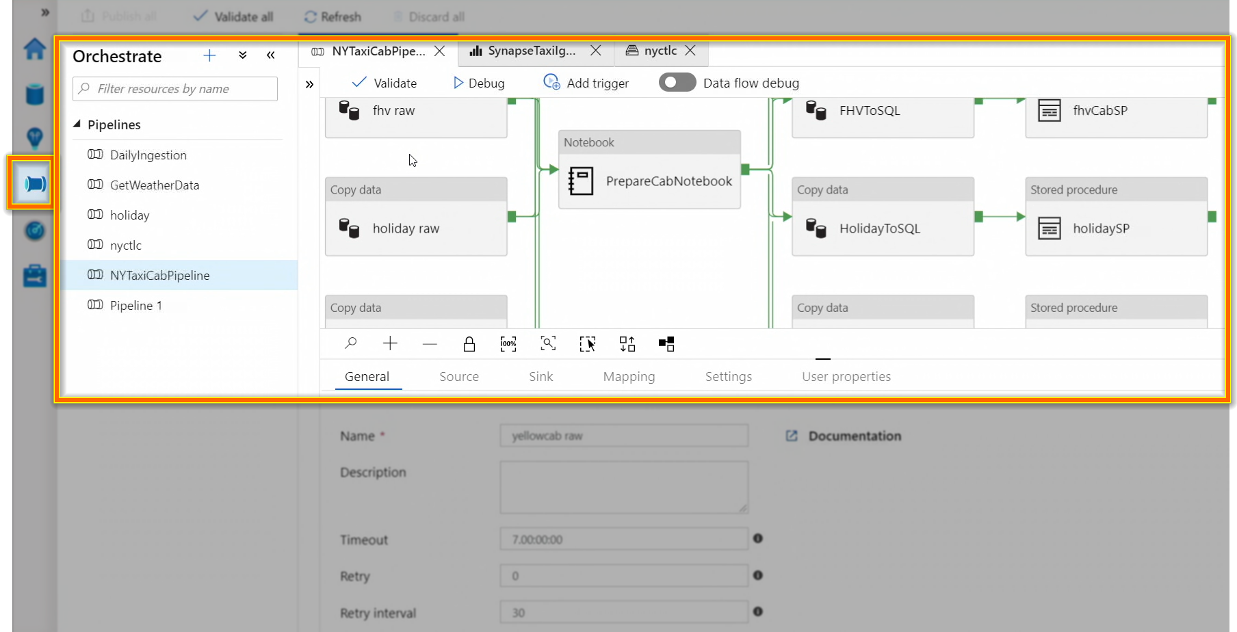
INGEST - Bring in the data

Slide 21
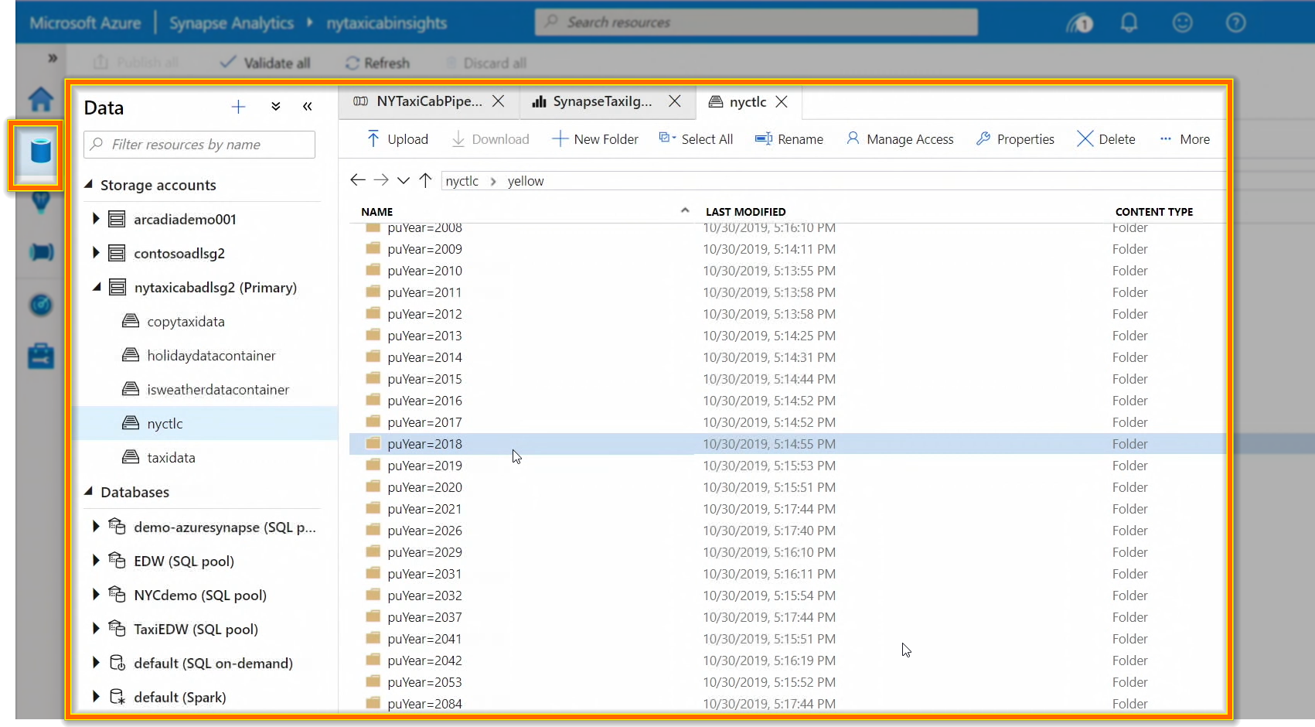
EXPLORE - Manage the data

Slide 22
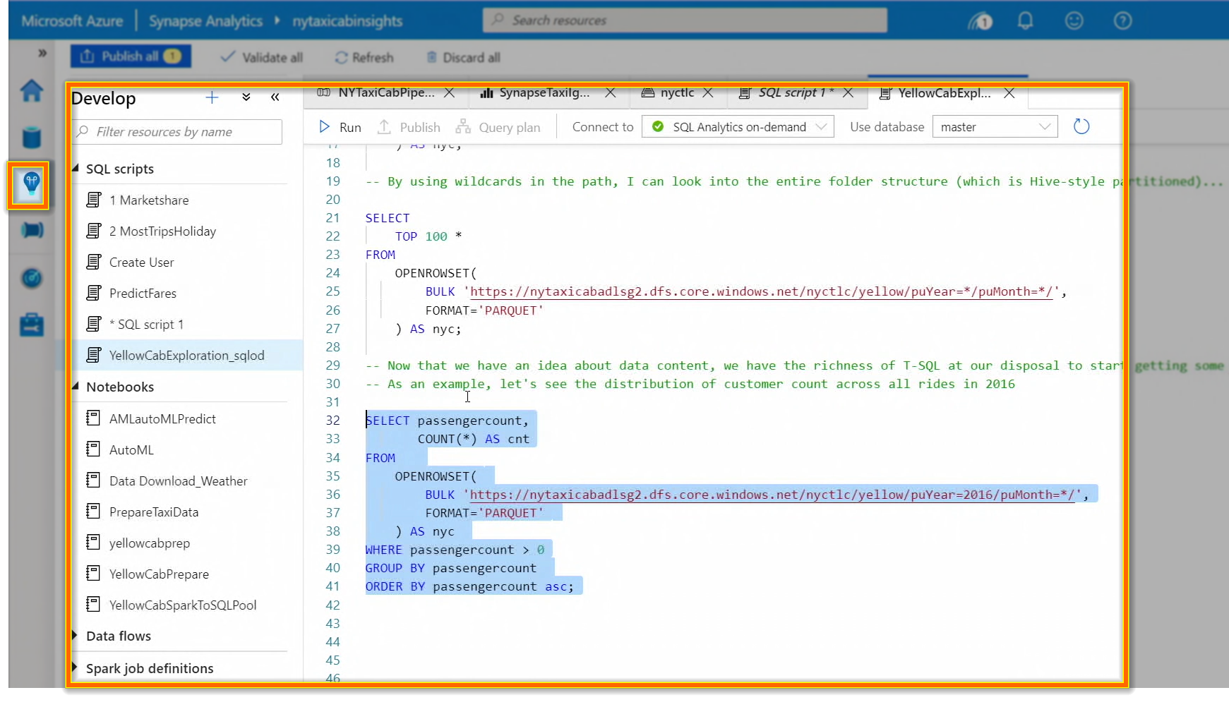
ANALYZE - Query the data (SQL / Python or R)
Full
Code
Notes:
Data Lake containing Parquet file can be queries with T-SQL. (Similar to Amazon Athena where we can do SQL query over Amazon S3 data). In the same interface you can also have usual notebook experience to use your favourite language like Python, R.

Slide 23
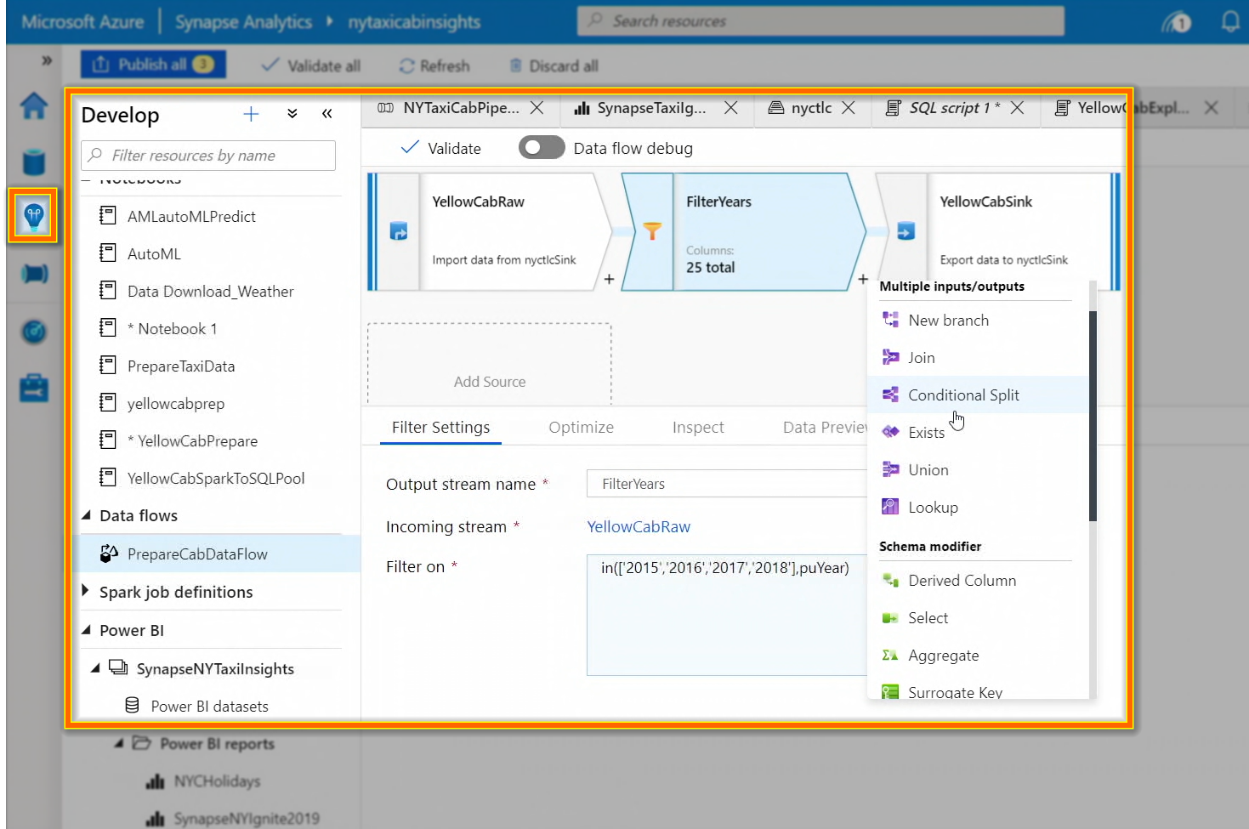
ANALYZE – Data Flows
Code
Free

Slide 24
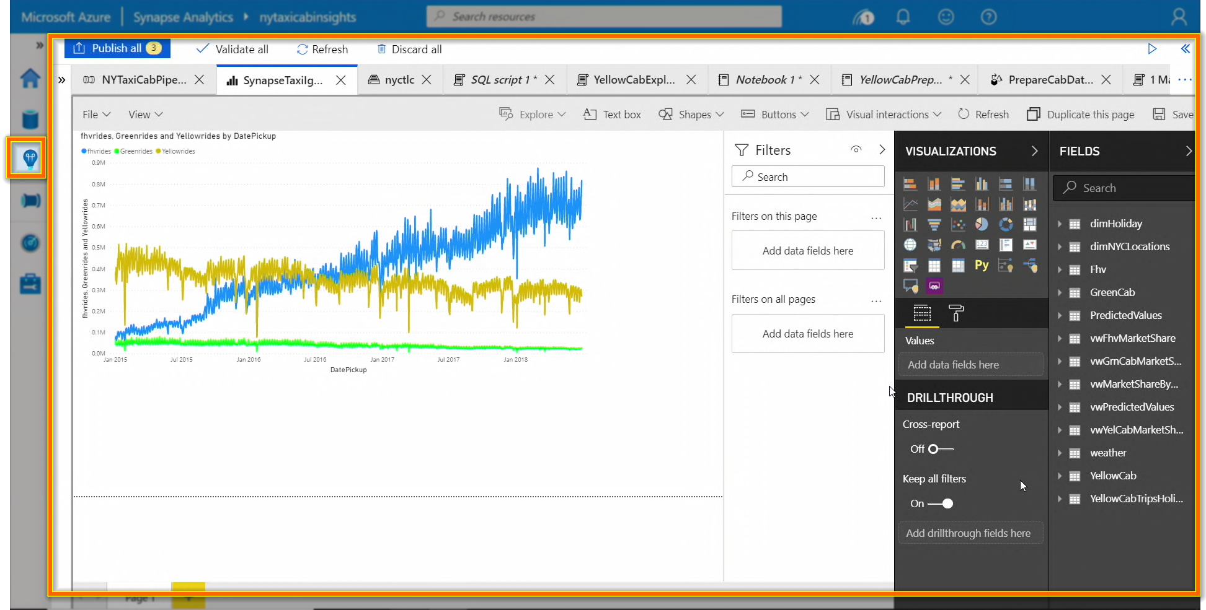
VISUALIZE – Create reports and publish

Slide 25
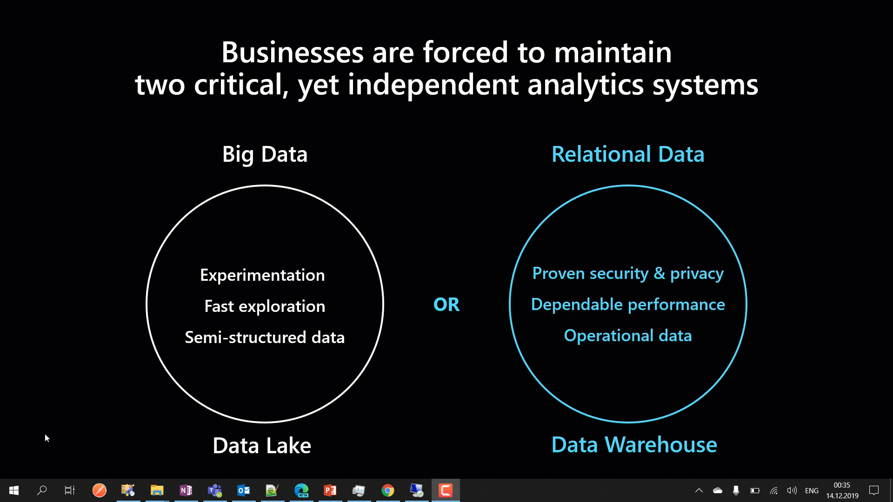
Notes:
Synapse Analytics combines Big Data and Relational Data to combine as one.

Slide 26
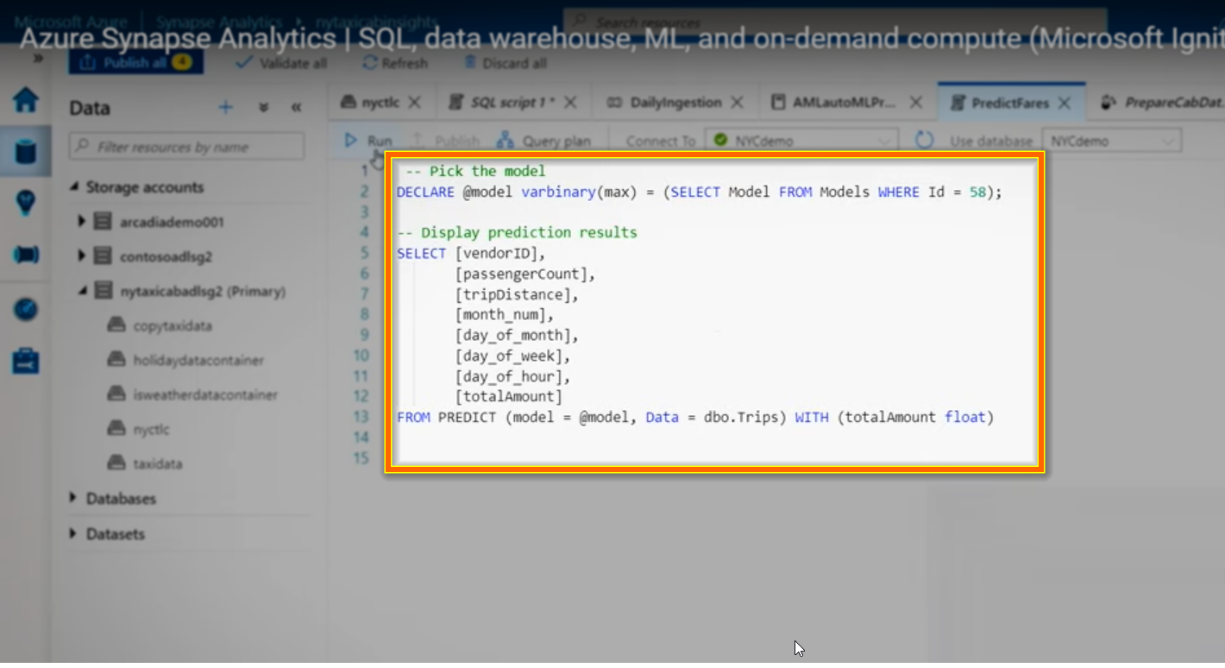
Bringing ML model into Warehouse
Notes:
Instead of exporting the data out to ML workspace, we are importing the MODEL into Warehouse where the data resides to be used for prediction.

Slide 27
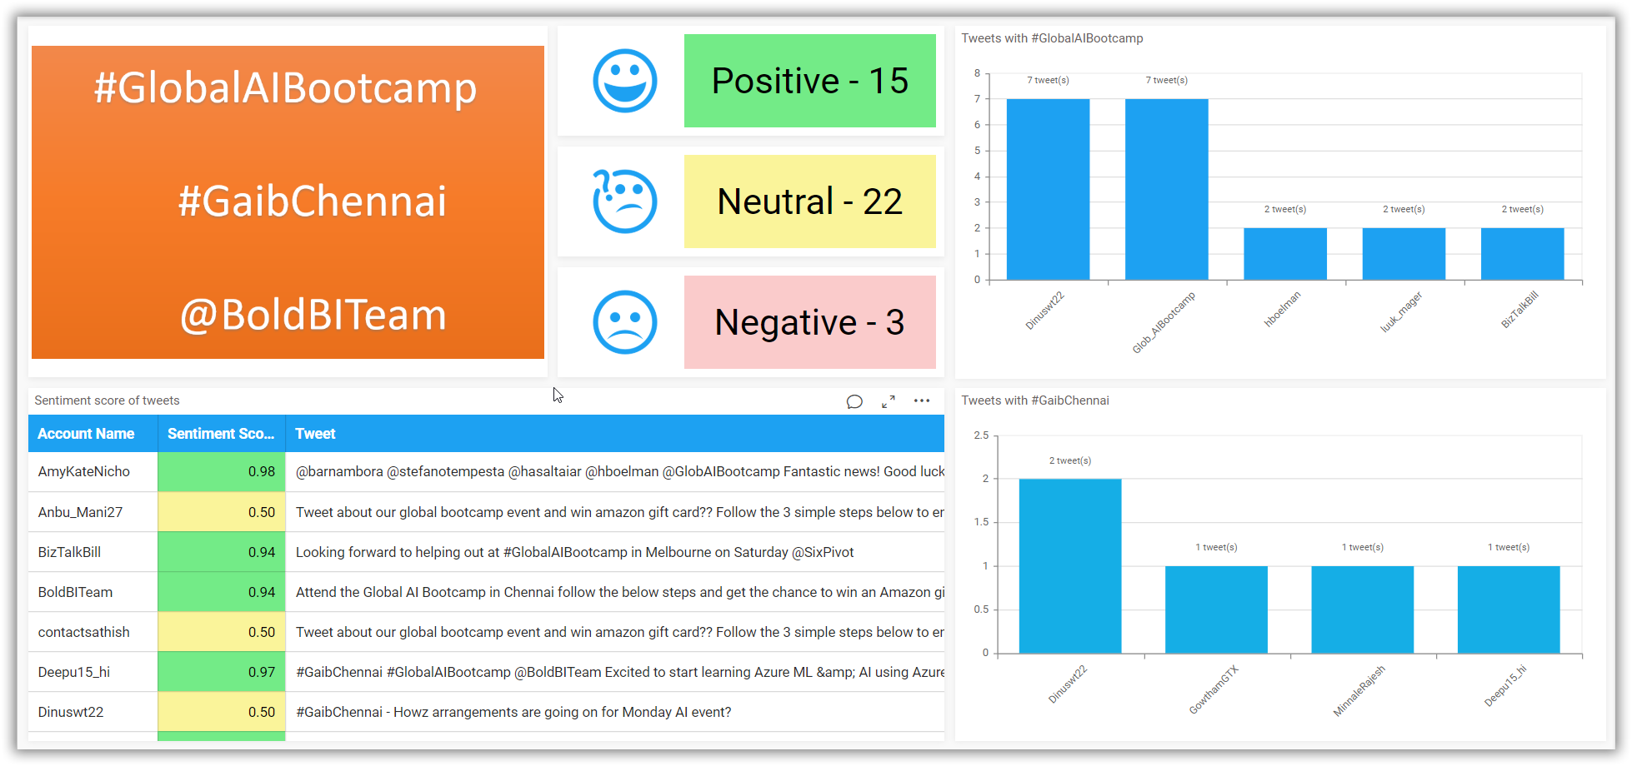
Notes:
REAL TIME sentiment analysis demo

Slide 28
Text Analytics Why Cognitive?
Up-to you to decide,
Create – Train – Train – Train – Use?
(or)
Buy – Use?

Slide 29
Tweets extracted via API
ETL – To extract needed information
Store into Azure SQL Warehouse
Visualize the dashboard and get instant insights
Notes:
Why I have used Warehouse instead of SQL database? Because I need to perform far more things like machine learning etc in future apart from just immediate visualization

Slide 30
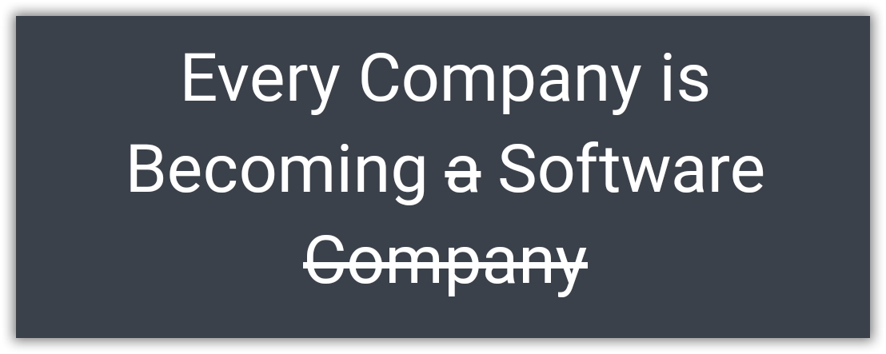
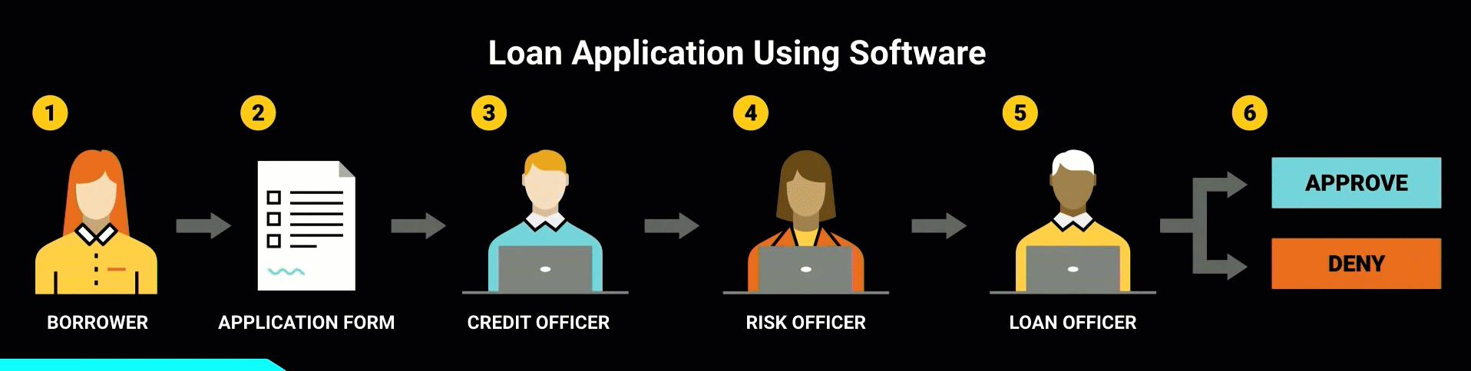
Borrowed from - https://www.youtube.com/watch?v=4QoCbhsQeyE
Notes:
Nowadays, a bank itself is software and takes the decision. Same case earlier humans took decisions using that software. A perfect example would be of sanctioning a personal loan. Things like the CIBIL score, a person’s authenticity available as up-to-date data has provided the power to decide to sanction a loan to machines themselves. Earlier, 1 or more bank employees should do the entire work of analyzing all these.
Finally I would like to end with this quote from Confluent.IO. “Every Company is Becoming software, which were previously just Using the software.”

Slide 31

dinuswt22
dinesh-kumar-prabakaran-b95a6656/
Notes:
Thank you so much for your patience and interest!

Slide 32
Questions?
Notes:
And now I am open to your questions.

